Slide 1
Computing the Neural Substrates of Attention and Awareness
Dan Birman
Gardner Lab
Kalanit Lab Meeting – 2015-02-06

Slide 2


Notes:
Show animation, then go back and repeat: asking to attend to background

Slide 3
Notes:
Show animation, then go back and repeat: asking to attend to background

Slide 4
Attention as a Pre-Requisite
Mack & Rock, 1998

Slide 5
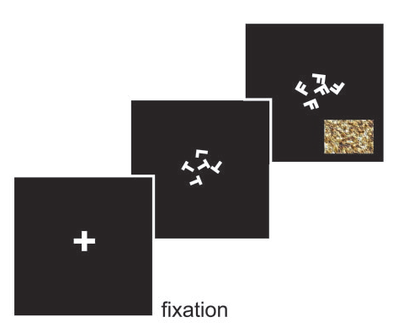
Gist Perception
Li et al., 2002
Reddy et al., 2004

Slide 6
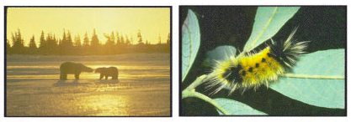
Gist Perception
Li et al., 2002
Reddy et al., 2004

Slide 7
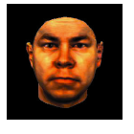
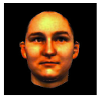
Gist Perception
Li et al., 2002
Reddy et al., 2004

Slide 8
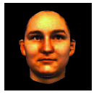
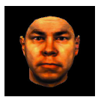
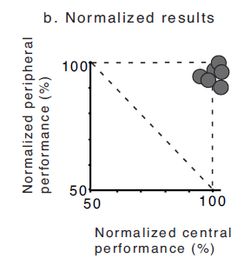
Gist Perception
Li et al., 2002
Reddy et al., 2004

Slide 9
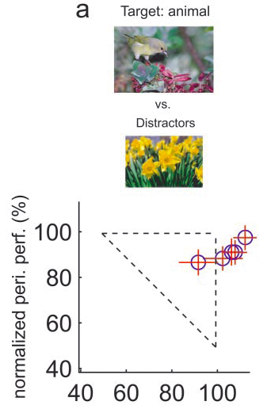
Gist Perception
Li et al., 2002
Reddy et al., 2004

Slide 10
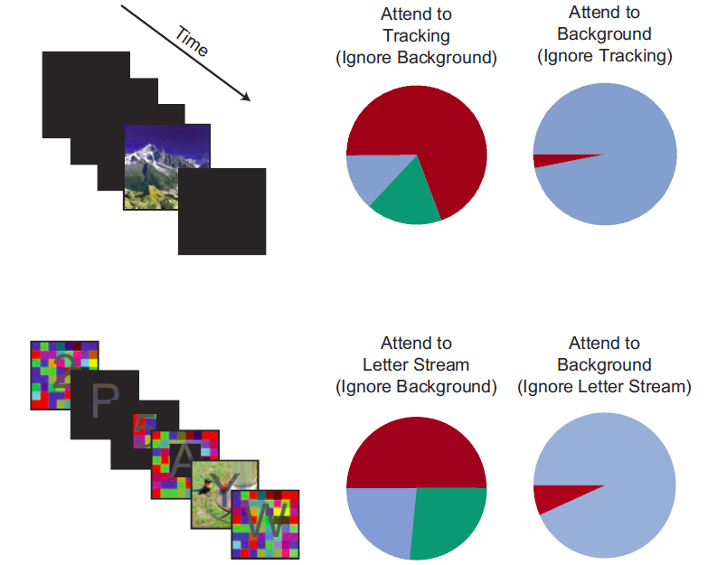
Gist Perception: Impossible Under Load?
Cohen et al., 2011

Slide 11
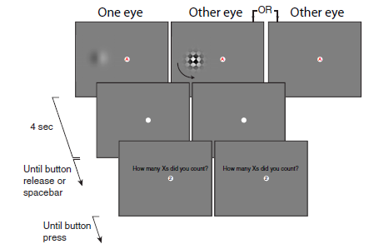
Attempts to Dis-Entangle Attention/Awareness
van Boxtel et al., 2010

Slide 12
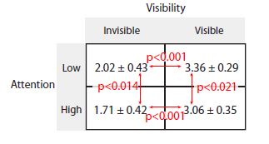
Attempts to Dis-Entangle Attention/Awareness
Afterimage Length (s)
van Boxtel et al., 2010

Slide 13

Operational Definitions vs. Neural Activity
http://www.globeimages.net/data/media/180/berlin_cathedral_front.jpg

Slide 14
Attention as a Pre-Requisite
Mack & Rock, 1998

Slide 15


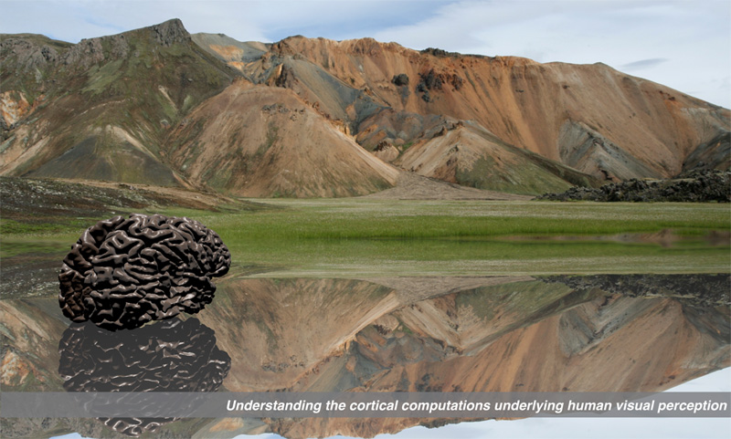
Gardner Lab @ Stanford University
Justin Gardner
Steeve Laquitaine

